Slide 1

5G Roaming Architecture
TCristian

Slide 2
Introduction
Allows usage of services of another mobile network
Quality of Service
Roaming specific functionalities
Security
So far: interworking between 5GS and EPS

Slide 3
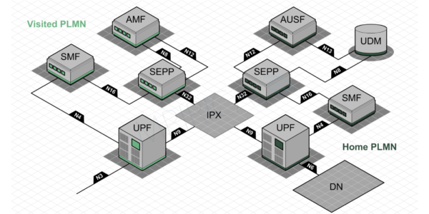
Architecture
5G Security when Roaming - Graeme Green

Slide 4
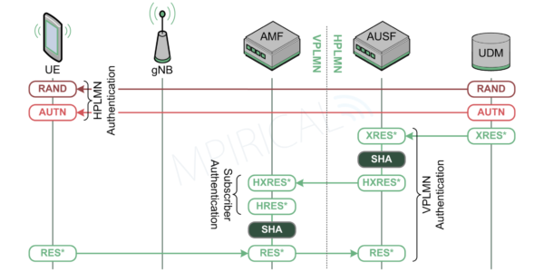
Authentication
5G Security when Roaming - Graeme Green

Slide 5
References
5G Security when Roaming – Grame Green
Roaming in the 5G System – Ericsson
A Comparative Introduction to 4G and 5G Authentication
3GPP 5G Security

